Slide 1
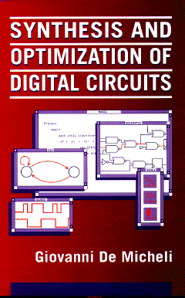


Two-level Logic Synthesis and Optimization
Giovanni De Micheli
Integrated Systems Laboratory
This presentation can be used for non-commercial purposes as long as this note and the copyright footers are not removed
© Giovanni De Micheli – All rights reserved

Slide 2
Module 1
Objectives
  Fundamentals of logic synthesis
  Mathematical formulation
  Definition of the problems

Slide 3
What is logic synthesis?
A logic-level representation is:
  A Boolean function
  A set of Boolean functions and their dependences
  A schematic with logic gates
  A logic-level HDL description
Logic synthesis is the process of optimizing logic representations with the final goal of:
  Speeding up a circuit
  Reducing its area and manufacturing cost
  Reducing the energy consumption

Slide 4
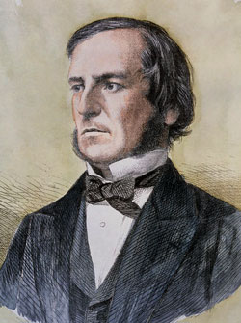

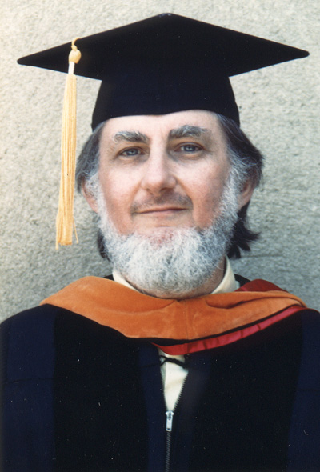


Logic synthesis has a long history
George Boole:
  Boolean Algebra
Claude Shannon
  Switching Theory
Modern logic synthesis
  Ed McCluskey, Robert Brayton, Randy Bryant
    … and many other noteworthy scientists

Slide 5
Combinational logic design
Background
Boolean Algebra
  Quintuple (B, +, . , 0, 1)
  Binary Boolean algebra B = { 0, 1 }
Boolean function
  Single output f : B^{n} → B
  Multiple output f : B^{n} → B^{m}
  Incompletely-specified:
    Don’t care symbol: *
    f : B^{n} → { 0, 1, * }^{m}
Notes:
An algebraic system is the combination of a set and one or more operations.
A Boolean algebra is defined by the set B and by two operations, denoted by + and .,which satisfy the commutative and distributive laws and whose identity elements are 0 and 1 respectively.
In addition, any element a has a complement, denoted by a’, such that a + a' =1 and a . a' = 0.
These axioms, which define a Boolean algebra, are often referred to as Huntington's postulates.
Note that a Boolean algebra differs from an ordinary algebra in that distributivity applies to both operations and because of the presence of a complement.

Slide 6
Examples of Boolean Algebras
Algebra of classes:
  Universal set S – classes are subsets of S
  2^{S} set of subsets of S
  Quintuple (2^{S}, U, Π , Ø, S)
Arithmetic Boolean algebra
  n = product of distinct primes
  D_{n} = divisors of n
  Quintuple (D_{n}, lcm, gcd , 1, n)
  Example n = 30 - ({1,2,3,5,6, 10, 15,30}, lcm, gcd, 1, 30)

Slide 7
The don’t care conditions
We do not care about the value of a function
Related to the environment
  Input patterns that never occur
  Input patterns such that some output is never observed
Very important for synthesis and optimization
Notes:
The points where the function is not defined are called don’t care conditions. They are related to the input patterns that can never occur and to those for which the output is not observed.
In the case of multiple-output function, DC points may differ for each component, because different outputs may be sampled under different conditions.

Slide 8
Definitions
Scalar function:
  ON-set
    Subset of the domain such that f is true
  OFF-set
    Subset of the domain such that f is false
  DC-set
    Subset of the domain such that f is a don’t care
Multiple-output function:
  ON, OFF, DC-sets defined for each component
Notes:
For each output, the subset of the domain for which the function takes the values 0, 1, and * is called the offset , onset and dcset respectively.
For multiple output functions, these sets are defined for each component.

Slide 9
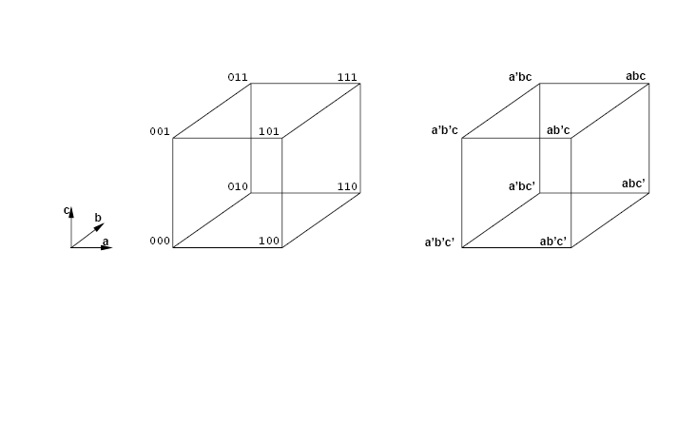
Cubical representation
Notes:
The multi-dimensional space spanned by n binary-valued Boolean variables is
denoted by B. It is often referred to as the n-dimensional cube, because it can be graphically represented as a hypercube.
A point in B is represented by a binary-valued vector of dimension n.
When binary variables are associated with the dimensions of the Boolean space, a point can be identified by the values of the corresponding variables.

Slide 10
Definitions
Boolean variables
Boolean literals:
  Variables and their complement
Product or cube:
  Product of literals
Implicant:
  Product implying a value of the function (usually 1)
  Hypercube in the Boolean space
Minterm:
  Product of all input variables implying a value of the function (usually 1)
  Vertex in the Boolean space
Notes:
A literal is an instance of a variable or of its complement. A product of n literalsdenotes a point in the Boolean space: it is a 0-dimensional cube.
Often, products of literals are called cubes.

Slide 11
Tabular representations
Truth table
  List of all minterms of a function
Implicant table or cover
  List of implicants sufficient to define a function
Note:
  Implicant tables are smaller in size as compared to truth tables
Notes:
Tabular forms are two-dimensional tables.
The tables can be partitioned into two parts, corresponding to the inputs and outputs of the function.
Tabular forms are also called personality matrices of a function.
The simplest tabular form is the truth table}
A truth table is a complete listing of all points in the Boolean input space and of the corresponding values of the outputs.
The most common tabular form is a list of {\it multiple-output implicants}.
A multiple-output implicant has an input and output part.
The input part represents a cube in the domain and is a row vector in {0,1,*}.
The output part has a symbol in correspondence to each output,

Slide 12
Example of truth table
x = ab+a’c; y = ab+bc+ac
abc | xy
000 | 00
001 | 10
010 | 00
011 | 11
100 | 00
101 | 01
110 | 11
111 | 11

Slide 13
Example of an encoded truth table
Using the reverse order:
  x = 11001010
  y = 11101000
Encoded in hexadecimal:
  x = ca
  y = e8
abc | xy
000 | 00
001 | 10
010 | 00
011 | 11
100 | 00
101 | 01
110 | 11
111 | 11

Slide 14
Example of implicant table
x = ab+a’c; y = ab+bc+ac
abc | xy
001 | 10
*11 | 11
101 | 01
11* | 11

Slide 15
Cubical representation of minterms and implicants
f₁ = a’b’c’ + a’b’c + ab’c + abc +abc’
f₂ = a’b’c + ab’c
111
γ
β
101
β
101
001
δ
001
α
110
c
b
a
000
f1
f2
Notes:
This example shows a 2-output function realized by 4 implicants, and their cubical notation.

Slide 16
Representations
Visual representations
  Cubical notation
  Karnaugh maps
Computer-oriented representations
  Matrices
    Sparse
    Various encoding
  Binary-decision diagrams
    Address sparsity and efficiency
Notes:
There are visual representations, for manual optimization, and CAD representations that are used by tools.
The most important representations are based on matrices and decision diagrams.

Slide 17
Module 2
Objectives
  Two-level logic optimization
  Motivation
  Models
  Exact algorithms for logic optimization

Slide 18
Two-level logic optimization motivation
Reduce size of the representation
Direct implementation
  PLAs reduce size and delay
Other implementation styles
  Reduce amount of information
  Simplify local functions and connections
Notes:
Two-level logic optimization is important in three respects.
First, it provides a means for optimizing the implementation of circuits that are direct translations of two-level tabular forms.
Thus two-level logic optimization has a direct impact on macro-cell design styles using Programmable Logic Arrays (PLAs).
Second, two-level logic optimization allows us to reduce the information needed to express any logic function that represents a component of a multiple-level representation. Specifically,
a module of a logic network may be associated with a logic function in two-level form, whose optimization benefits the overall multiple-level representation. Thus, two-level optimization is of key importance to multiple-level logic design.
Last but not least, two-level logic optimization is a formal way of processing the representation of systems that can be described by logic functions. Hence its importance goes beyond logic circuit design.

Slide 19
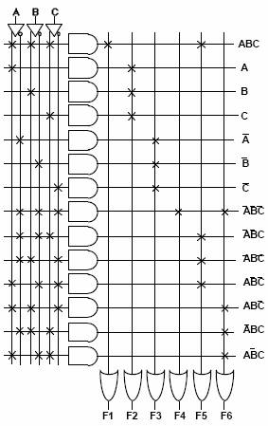
Programmable logic arrays
Macro-cells with rectangular structure
  Implement any multi-output function
Programmable
  Old technology using fuses
  Grandfather of FPGAs
Programmed
  Layout generated by module generators
  Fairly popular in the seventies/eighties
Advantages
  Simple, predictable timing
Disadvantages
  Less flexible than cell-based realization
  Dynamic operation in CMOS
Open issue
  Will PLA structures be useful with new nanotechnologies?
Notes:
PLAs are rectangular macrocells, mainly used within NMOS technology.
Dynamic CMOS PLAs also exist.
There is a renewed interests in using PLAs for new nano-technologies.

Slide 20
Pseudo NMOS PLA
V
DD
GND
GND
GND
GND
GND
GND
GND
V
DD
X
0
X
0
X
1
X
1
X
2
X
2
f
0
f
1
AND-plane
OR-plane

Slide 21
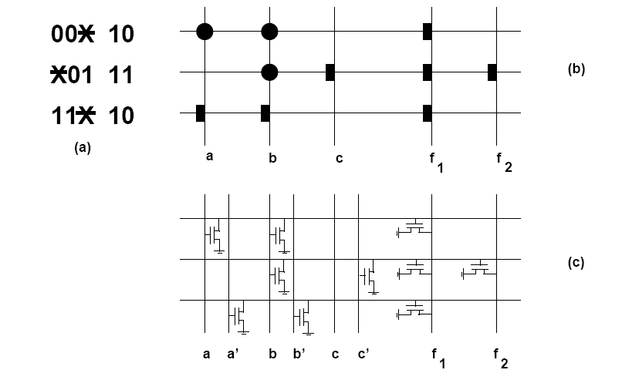
Programmable logic array
f₁ = a’b’ + b’c + ab; f₂ = b’c
Notes:
A PLA has a set of rows in one to one correspondence with the implicants.
It has column pairs, in correspondence with inputs and their complements.
It has output columns in correspondence with the outputs.
PLAs implement typically sum of products in terms of NORS of NORS. The final outputs need to be complemented.
PLAs can be seen as two planes, each realizing NORs.
Transistors are placed in specific positions, to implement the NORs. The example shows the translation of a personality matrix into a PLA array.

Slide 22
Two-level minimization
Assumptions
  Primary goal is to reduce the number of implicants
  All implicants have the same cost
  Secondary goal is to reduce the number of literals
Rationale
  Implicants correspond to PLA rows
  Literals correspond to transistors
Notes:
The objective of two-level logic minimization is to reduce the size of a Boolean function in either sop or pos form.
Since either form can be derived from the other by using De Morgan's law which preserves the number of terms and literals, we can concentrate on the minimization of one form, in particular sop without loss of generality.

Slide 23
Definitions
Minimum cover
  Cover of a function with minimum number of implicants
  Global optimum
Minimal cover or irredundant cover
  Cover of the function that is not a proper superset of another cover
  No implicant can be dropped
  Local optimum
Minimal w.r.to 1-implicant containment
  No implicant contained by another one
  Weak local optimum
Notes:
The objective of exact two-level logic minimization is to determine
a minimum cover of a function, I.e., a cover with a minimum number of terms.
It is often useful to determine local minimum covers, called minimal covers, because their computation can be achieved with smaller memory and computing-time requirements.
Different definitions of minimality exist.

Slide 24
Example
f₁ = a’b’c’ + a’b’c + ab’c + abc +abc’; f₂ = a’b’c + ab’c
β
β
δ
Minimum cover
α
γ
β
δ
Irredundant cover
α
β
γ
β
δ
Minimal cover w.r. to single implicant containment
α
f1
f2
Notes:
Example of a 3-input, 2-output, 5-minterm function.
A minimun cover has 3 implicants.
A minimal cover has 4 implicants, because two outputs do not share a term.
A cover, which is minimal with respectt to single containment, has again 4 implicants.

Slide 25
Definitions
Prime implicant
  Implicant not contained by any other implicant
Prime cover
  Cover of prime implicants
Essential prime implicant
  There exist some minterm covered only by that prime implicant
  Needs to be included in the cover
Notes:
Implicants are prime when no other implicant (of the same function) contains them.
Essential primes are the only ones that cover a specific minterm.

Slide 26
Two-level logic minimization
Exact methods
  Compute minimum cover
  Often difficult/impossible for large functions
  Based on Quine-McCluskey method
Heuristic methods
  Compute minimal covers (possibly minimum)
  Large variety of methods and programs
    MINI, PRESTO, ESPRESSO
Notes:
Exact logic minimization addresses the problem of computing a minimum cover.
It is considered a classic problem in switching theory and it was addressed first by Quine and McCluskey.
Heuristic logic minimization strives at computing minimal covers in short time.

Slide 27
Exact logic minimization
Quine’s theorem:
  There is a minimum cover that is prime
Consequence
  Search for minimum cover can be restricted to prime implicants
Quine-McCluskey method
  Compute prime implicants
  Determine minimum cover
Notes:
The solution of the exact minimization hinges on Quine's theorem that delimits the search space for an optimum solution.
The theorem says: “There is a minimum cover that is prime.”
Thus exact minimization determines a list of primes, and then selects a minimum number that is sufficient to cover the function.

Slide 28
Prime implicant table
Rows: minterms
Columns: prime implicants
Exponential size
  2^{n} minterms
  Up to 3^{n} / n prime implicants
Remarks
  Some functions have much fewer primes
  Minterms can be grouped together
  Implicit methods for implicant enumeration
Notes:
A prime implicant table is a binary-valued matrix A, whose columns are in one-to-one correspondence with the prime implicants of the function f and whose rows are in one-to-one correspondence with its minterms.
The table has exponential size, but still tables can be generated for small-medium scale functions.
There are implicit methods that do not construct the table, but gather the equivalent information in a data structure.

Slide 29
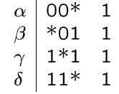
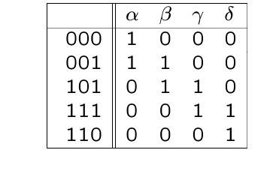
Example
f = a’b’c’ + a’b’c + ab’c +abc +abc’
Primes:
Table:
β
γ
δ
α
Prime implicants of f
β
δ
α
Minimum cover of f
Notes:
Exanple of a 3-input scalar function.
There are 4 primes and 5 minterms.
Two primes are essential, because they are the only ones that cover two minterms.

Slide 30
Minimum cover early methods
Reduce table
  Iteratively identify essentials,
  save them in the cover.
  Remove covered minterms
Petrick’s method
  Write covering clauses in pos form
  Multiply out pos form into sop form
  Select cube of minimum size
Remark
  Multiplying out clauses has exponential cost
Notes:
The implicant table can be reduced by techniques similar to those used for the generic covering problem.
In particular, each essential column corresponds to an essential prime, which must be part of any solution.
Row and column dominance can be used to reduce the size of matrix A.
Extraction of the essentials, and removal of dominant rows and dominated columns can be iterated to yield a reduced prime implicant table.
Another classic approach, often referred to as Petrick's method, consists of writing down the covering clauses of the (reduced)
implicant table in pos form. Each clause (or equivalently each product term) corresponds to a minterm and it represents the disjunction of the primes that cover it.
The pos form is then transformed into a sop form by carrying out the products of the sums. The corresponding sop expression is satisfied when anyone of its product terms is true.
In this case, product terms represent the primes that have been selected.
The cost of a cover then relates to the number of literals in the product.
As a result, a minimum cover is identified by any product term of the sop form with the fewest literals.

Slide 31
Example
pos clauses
  (α) (α + β) (β + γ) (γ + δ) (δ) = 1
sop form:
  αβδ + αγδ = 1
Solutions:
{ α β δ }
{ α γ δ }
β
γ
δ
α
Notes:
In this example, two optimum solutions are defined in the pos form by the two implicants with 3 variables.

Slide 32
Matrix representation
View table as Boolean matrix: A
Selection Boolean vector for primes: x
Determine x such that
  A x ≥ 1
  Select enough columns to cover all rows
Minimize norm (1 count) of x
Notes:
The prime implicant table can be seen as a matrix A and the problem can be cast as an ILP.
This approach is seldom used.

Slide 33
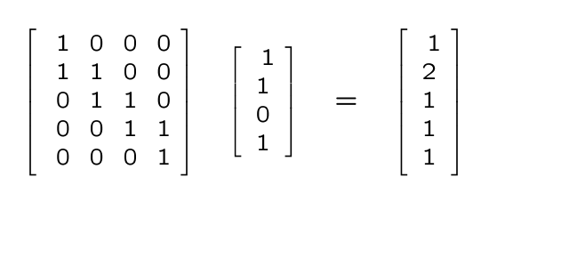
Example
Notes:
In this example, the vector on the left shows a solution, comprising the first, second and fourth implicant.
The vector on the right shows the number of implicants that cover each minterm: all minterms are covered at least once.

Slide 34
Covering problem
Set covering problem:
  A set S -- minterm set
  A collection C of subsets (implicant set)
  Select fewest elements of C to cover S
Computationally intractable problem
Exact solution method
  Branch and bound algorithm
Several heuristic approximation methods
Notes:
Exact minimization can be best modeling as a set covering problem.
Since this method is intractable, exact solution can be achieved by a branch and bound algorithm which has exponential worst-case complexity.
Else, the solution can be approximated by means of heuristics.

Slide 35
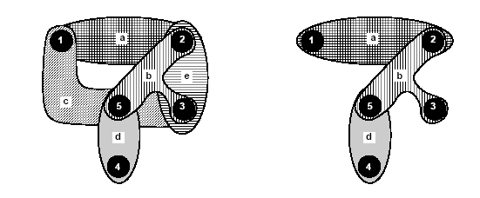
Example
Edge-cover of a hypergraph
Notes:
This example shows set covering modeled as edge covering in hypergraphs.

Slide 36
Branch and bound algorithm
Tree search in the solution space
  Potentially exponential
Use bounding function:
  If the lower bound on the solution cost
  that can be derived from a set of future choices
  exceeds the cost of the best solution seen so far,
  then kill the search
  Bounding function should be fast to evaluate and accurate
Good pruning may expedite the search
Notes:
The branch-and-bound algorithm is based on the idea of visiting only a part of the decision tree.
For each branch, i.e. local decision on the value of a variable, a lower bound is computed for all solutions in the corresponding subtree.
If that bound is higher than the cost of any solution found so far, the subtree is pruned, because all its leaves would yield a solution of provably higher cost.
For example, when solving an ILP, a lower bound can be computed by solving the corresponding LP after relaxing the integer constraints.

Slide 37
Example
r
Bound = 6
Kill sub-tree
a
b
x
y
w
z
5
4
9
8
Notes:
Consider a problem with four possible solutions. The decision tree visualizes the sequences of decisions.
Thus the root corresponds to r and the two branching decisions from the root lead to vertices a and b.
Solutions correspond to the leaves of the tree.
The number below each leaf in is the cost of the corresponding solution.
Assume that the branch-and-bound algorithm visits first the subtree rooted in a.
The algorithm finds a solution x with cost 5, which is later updated to y with cost 4.
The the algorithm visits the subtree rooted in b. Since a cost estimate gives a bound of 6,
Then there is no solution better than y in the subtree. The subtree is killed, and y declared the optimum.

Slide 38
Branch and bound for logic minimization
Reduction strategies
Use matrix formulation of the problem
Partitioning:
  If A is block diagonal:
    Solve covering problems for the corresponding blocks
Essentials
  Column incident to one (or more) rows with single 1
    Select column
    Remove covered row(s) from table
Notes:
We consider a branch-and-bound algorithm for the covering problem.
We assume that a covering problem is specified by matrix A, with rows corresponding to the elements of the set to be covered, and columns corresponding to groups of elements.
The problem can be simplified if it can be partitioned into independent subproblems.
The problem can also be simplified by computing and removing the essentials.

Slide 39
Branch and bound for logic minimization
Reduction strategies
Column (implicant) dominance:
  If a_{ki} ≥ a_{kj} for all k
    Remove column j (dominated)
  Dominated implicant ( j ) has its minterms already covered by dominant implicant ( i )
Row (minterm) dominance:
  If a_{ik} ≥ a_{jk} for all k
    Remove row i (dominant)
  When an implicant covers the dominated minterm, it also covers the dominant one
Notes:
A column dominates another column if the entries of the former are larger than, or equal to, the corresponding entries of the latter.
Equivalently, an edge dominates another edge when it is incident to at least all vertices incident to the other.
Dominated columns (edges) can be discarded from consideration.
A row dominates another row, if the entries of the former are larger than, or equal to, the corresponding entries of the latter.
Equivalently, a vertex dominates another vertex when it is incident to at least all edges incident to the other.
Dominant rows (vertices) can be neglected, because any cover of the dominated ones is also a cover of the complete set.

Slide 40
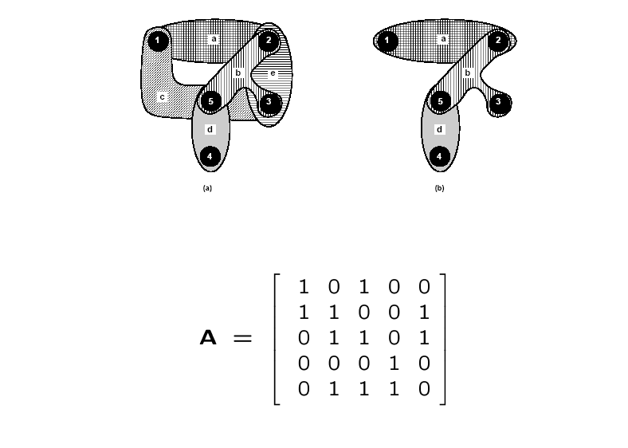
Example
Notes:
Example of a covering matrix A and corresponding hypergraph.

Slide 41
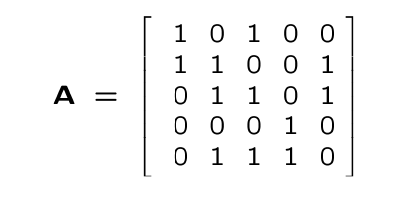
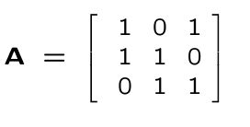
Example
Fifth row is dominant
Fourth column is essential
Fifth column is dominated
Matrix after reductions:
Notes:
Dominance matrix and cyclic core.

Slide 42
Branch and bound covering algorithm
EXACT_COVER(A,x,b) {
Reduce matrix A and update corresponding x;
if (current_estimate ≥ |b|) return (b);
if (A has no rows) return(x);
select a branching column c;
x_{c} = 1;
Ã = A after deleting c and rows incident to it;
x~ = EXACT_COVER(Ã,x,b);
if ( | x~| < |b| )
b = x~;
x_{c} = 0;
Ã = A after deleting c;
x~ = EXACT_COVER(Ã,x,b);
if ( | x~| < |b| )
b = x~;
return(b);
}
Notes:
Refer to the textbook for a detailed explanation.
At the first step, the reduction of matrix A is done as follows.
First, if matrix A is reducible (i.e. it can be reordered into a block-diagonal form, because it represents two or more disjoint sub-problems), EXACT_COVER is invoked on its partition blocks and the current solution x is set to the disjunction of the return values.
Second, dominated columns, dominant rows and essential columns are iteratively
removed until there is no change. For every essential column detected and deleted,
the corresponding entry in x is set to 1 and the rows to which it is incident are deleted as well.
The branch-and-bound algorithm explores the solution space recursively, by assuming that each column is included or excluded from the cover.
In the first case, the recursive call has argument a reduced matrix A
where the column being included is deleted as well as the rows incident to that column.
In the second case, the recursive call has argument a reduced matrix A, where the column being excluded is deleted.

Slide 43
Bounding function
Estimate lower bound on covers that can be derived from current solution vector x
The sum of the 1s in x, plus bound of cover for local A
  Independent set of rows
    No 1 in the same column
    Require independent implicants to cover
  Construct graph to show pairwise independence
  Find clique number
    Size of the largest clique
  Approximation (lower) is acceptable
Notes:
The bounding is done by the evaluation of Current_estimate, that is a lower bound of the cardinality of all covers that can be derived from the current x.
The estimate is the sum of two components.
The number of ones in x (i.e. the number of columns already committed) plus a bound on the size of the cover of the current A.
Such a bound can be given by the size of a maximally independent set of rows, i.e. rows that have no ones in the same column.
Pairwise independence can be easily identified and a graph can be constructed whose vertices are in one-to-one correspondence with the rows (vertices in the original hypergraph) and whose edges denote independence.
The bound is the clique number in this graph.
Computing an exact bound is difficult, because identifying the maximum clique is as complex as solving the covering problem itself.
However any lesser approximation (that can be computed by a fast heuristic algorithm) is valuable.
The worse the approximation is, the less pruning the algorithm does. In any case, the algorithm is still exact.

Slide 44
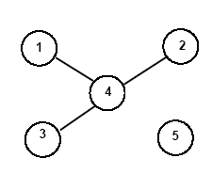
Example
Row 4 independent from 1,2,3
Clique number and bound is 2
Notes:
In this example the bound is 2. (Clique number)

Slide 45
Example
There are no independent rows
  Clique number is 1 (one vertex)
  Bound is 1+1= 2
    Because of the essential already selected
  0 1
  1 1 0
  0 1 1
A =
Notes:
Solving the cyclic core. The bound is 1 for the core, and 2 overall.

Slide 46
Example
Branching on the cyclic core
Select first column
  Recur with Ã = [11]
    Delete one dominated column
    Take other column (essential)
  New cost is 3
Exclude first column
  Find another solution with cost equal to 3.
  Discard
  0 1
  1 1 0
  0 1 1
A =
Notes:
Solving the cyclic core.
If we select the first column, then we can reduce the matrix to [11], and pick any one remaining column.
If we exclude the first column, we would find a solution with the same cost.
Thus either solution is good, and we keep the first one we find.

Slide 47
Espresso-exact
Exact 2-level logic minimizer
Exploits iterative reduction and branch and bound algorithm on cyclic core
Compact implicant table
  Rows represent groups of minterms covered by the same implicants
Very efficient
  Solves most benchmarks
Notes:
Espresso exact is a logic minimizer that implements these ideas with some further technical refinement.
Most benchmark circuits are solved by espresso exact.

Slide 48
Example
After removing the essentials
0111
α 0 * * 0 1
1011
β * 0 * 0 1
0110
γ 0 1 * * 1
 | α | β | ε | ζ
0000,0010 1101 | 1 0 | 1 0 | 0 1 | 0 1
1010
0010
δ 1 0 * * 1
0100
ε 1 * 0 1 1
0000
1101
ζ * 1 0 1 1
0101
1001
c
b
d
a
Notes:
Prime implicant table.
Note that in espresso exact minterms can be grouped together when their relation to implicants is the same.

Slide 49
Exact two-level minimization
There are two main difficulties:
  Storage of the implicant table
  Solving the cyclic core
Implicit representation of prime implicants
  Methods based on binary decision diagrams
  Avoid explicit tabulation
Recent methods make 2-level optimization solve exactly almost all benchmarks
  Heuristic optimization is just used to achieve solutions faster
Notes:
Overall exact minimization has two difficulties: storing the implicant table and solving the cyclic core.
The former problem can be solved by implicit methods, that do not require the explicit representation of the table.
The latter problem is usually handled well by B&B algorithms.

Slide 50
Module 3
Boolean Relations
  Motivation of using relations
  Optimization of realization of Boolean relation
  Comparisons to two-level optimization

Slide 51
Boolean relations
Generalization of Boolean functions
More than one output pattern may correspond to an input pattern
  Multiple-choice specifications
  Model inner blocks of multi-level circuits
Degrees of freedom in finding an implementation
  More general than don’t care conditions
Problem:
  Given a Boolean relation, find a minimum cover of a compatible Boolean function that can implement the relation
Notes:
Boolean relations are generalizations of Boolean functions, where each input pattern may correspond to more than one output pattern.
As a result, a relation is specified by a subset of the Cartesian product of the input and output Boolean spaces.
In general, Boolean relations are useful in specifying combinational circuits that can be implemented by different logic functions.
Thus Boolean relations provide a more general interpretation of the degrees of freedom in logic optimization than DC conditions.
Usually, we care about constructing a circuit, represented by a Boolean function, which is compatible with the Boolean relation specification.
We also want a minimum cost realization.

Slide 52
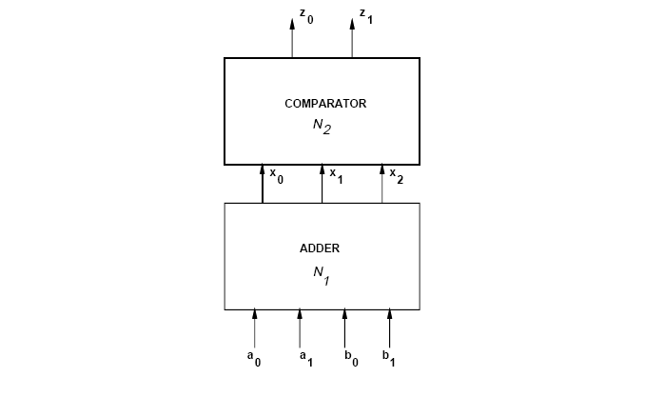
Example
Compare:
  a + b > 4 ?
  a + b < 3 ?
Notes:
Consider two interconnected circuits. The former is a two-bit adder that takes four inputs and yields three outputs.
The latter circuit is a comparator, whose inputs are the outputs of the adder and whose outputs encode the result of a comparison of the sum with the constants three and four, as shown in the figure.
Namely the comparator's output denote if the sum, encodes an integer smaller than three, equal to either three or four, or larger than four.

Slide 53
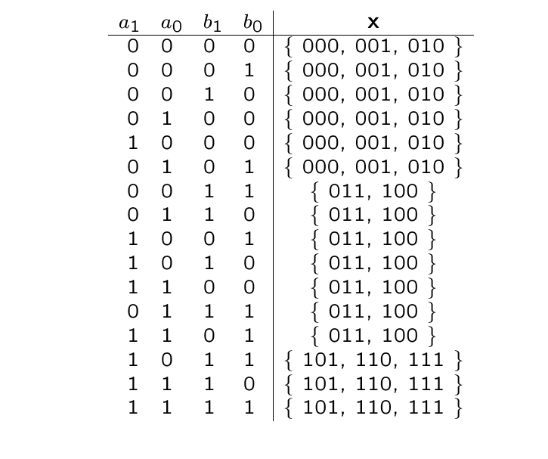
Example
Note that output 111
cannot be a+b but can be
considered as a don’t care
Notes:
Consider now the adder circuit, and assume that its output x is observed by the comparator only.
Thus all patterns of x that encode integers smaller three are equivalent as far as producing the comparator's output.
Similar considerations apply to those patterns encoding integers larger than four, and to those encoding three and four.
The Boolean space spanned by x can then be partitioned into three equivalent classes.
The adder can be expressed by the relation table in the figure.

Slide 54
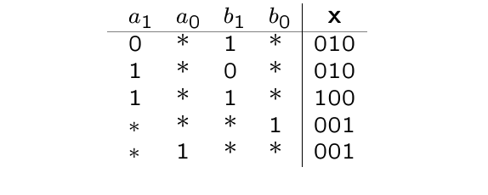
Example
Circuit is no longer an adder
Notes:
The optimization problem consists of finding a minimum (or minimal) cover of a Boolean function to which this relation table can be reduced.
As an example, we show here the result of minimizing the Boolean relation. Note that the circuit is no longer an adder, but the final outcome is correct.

Slide 55
Minimization of Boolean relations
Since there are many possible output values (for any input), there are many logic functions implementing the relation
  Compatible functions
Problem
  Find a minimum compatible function
Do not enumerate all compatible functions
  Compute the primes of the compatible functions
    C-primes
  Derive a logic cover from the c-primes
Notes:
A Boolean relation specifies implicitly many Boolean functions, i.e. all those functions whose output patterns are among those specified by the relation.
Such functions are said to be compatible with the relation.
Since there are many compatible functions, deriving and minimizing all of them is not an efficient method for determining the best implementation.
Therefore, exact (and heuristic) methods for finding directly the minimum (or minimal) Boolean function compatible with a Booelan relation have been proposed.

Slide 56
Binate covering
Covering problem is more complex
  As compared to minimizing logic functions.
In classic Boolean minimization we just need enough implicants to cover the minterm
  Covering clause is unate in all variables
  Any additional implicant does not hurt
In Boolean relation optimization, we need to pick implicants to realize a compatible function
  Some implicants cannot be taken together
  Covering clause is binate (implicant mutual exclusion)
  Non-compact Boolean space
Notes:
When considering Boolean relations, for each specified input pattern (i.e. minterm) we create a clause, that states which combination of primes would yield a correct output.
Differently from the case of Boolean functions, the selection of a c-prime may imply the selection of another c-prime.
This implication may be represented by a clause with a complemented variable.
The covering expression is again the product of all clauses, and it may be binate in some variables.
In other words, the exact Boolean relation minimization problem differs from the Boolean function optimization problem in that it requires the solution of a binate covering problem, rather than a unate covering problem.

Slide 57
Solving binate covering
Binate cover can be solved with branch and bound
  In practice much more difficult to solve, because it is harder to bound effectively
Binate cover can be reduced to min-cost SAT
  SAT solvers can be used
Binate cover can be also modeled by BDDs
Several approximation algorithms for binate cover
Notes:
Binate covering can be solved exactly by the branch-and-bound algorithm, but it is in general harder to solve than unate covering.
It can also be transformed into a satisfiability problem, and solved by a specialized solver.

Slide 58
Summary: Boolean Relations
Generalization of Boolean functions
  More degrees of freedom than don’t care sets
Useful to represent multiple choice
Useful to model internals of logic networks
Elegant formalism, but computationally-intensive solution method
Notes:
In summary, Boolean relations are a generalization of Boolean functions.
They can express non-determinism, and are useful for circuit specification.
They are also used within multi-level logic synthesis.

